Slide 1



JavaScript Development Tools
Know your Tools!
JavaScript Fundamentals
Telerik Software Academy
http://academy.telerik.com

Slide 2
Table of Contents
JavaScript Development Tools
Visual Studio 2013
Sublime Text 2 with plugins
Notepad++
Debugging tools
Google Chrome / Opera Developer Tools
Firefox Firebug
Internet Explorer F12
Utilities

Slide 3

JavaScript Tools
Know your Tools!

Slide 4
JavaScript Tools
JavaScript is an interpreted language
It is run and executed by the browser
The means to acquire the JavaScript code are trivial
No matter how or where it is coded
A simple Notepad will do the trick
Yet, there are many tools that easify JavaScript coding
Like editors, debuggers, etc…

Slide 5


JavaScript Development Tools
Coding JavaScript made easy!

Slide 6
JavaScript Development Tools
All a developer needs for coding JavaScript is a text editor
Notepad/Notepad++ will do the trick
Yet, JavaScript is one of the popular guys now
Many, many tools for coding JavaScript
Sublime Text 2 / Sublime Text 3
Visual Studio 2012/2013
Adobe Brackets, Cloud9, Telerik AppBuilder
JavaScript Development Tools for Eclipse

Slide 7
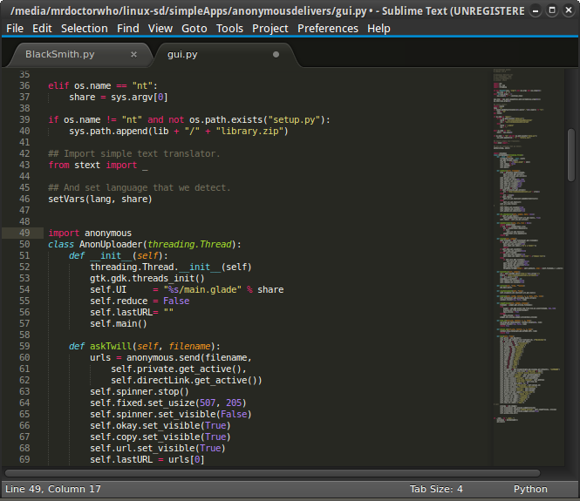
Sublime Text 2
A lightweight development editor

Slide 8
Sublime Text 2
Sublime Text is a sophisticated text editor for code, markup and prose
Free to download: http://www.sublimetext.com/2
Sublime text has many useful features, not directly related to coding
Navigation between files
Multiple selection
Command Palette
Customizable – write your own plugins

Slide 9
Working with Sublime Text 2
Goto Anything
Easier navigation between files
Triggered with “CTRL + P”
Command Palette
Execute commands
Triggered with “CTRL + SHIFT + P”
Multiple Selection
Change at multiple places at the same time
Hold CTRL and right-click

Slide 10
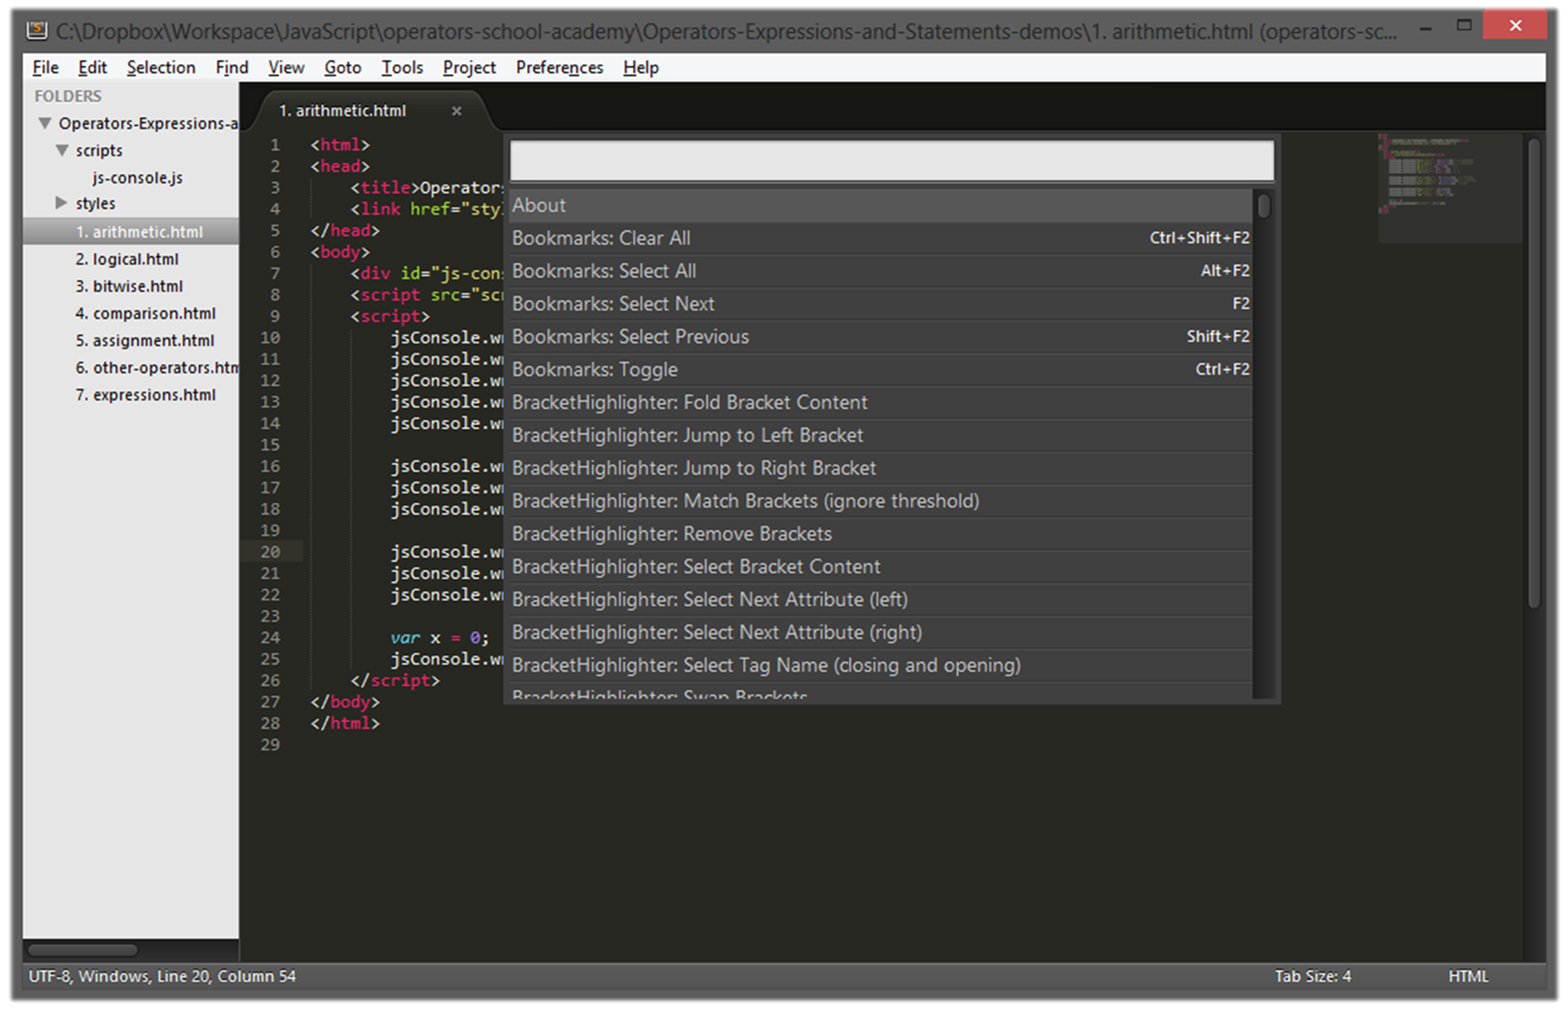
Working with Sublime Text 2
Live Demo

Slide 11
Sublime Text 2 Plugins
Plugins extend the power of Sublime Text
Code highlighting
Autocompletion / intellisense
And more
Plugins can be installed two ways:
Download the package, paste it in a special folder of Sublime Text and you are ready to go
Or, install the “Package Control” plugin and then install plugins directly from Sublime Text

Slide 12
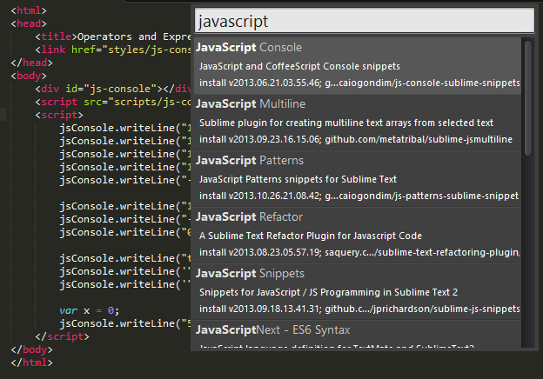
Installing Plugins for Sublime Text 2
Live Demo

Slide 13
Sublime Text 2 Useful Plugins
There are almost indefinite number of Sublime Text 2 plugins
List of useful Sublime Text 2 plugins
IndentGuides – marks the indents (tabs)
StatusBarExtension – adds encoding to the status bar
ClipboardHistory – history of Copy & Paste
Nettuts+ Fetch – easier fetching of files
SiderBarEnhancements – extensions to sidebars
SublimeCodeIntel – adds code intellisense

Slide 14
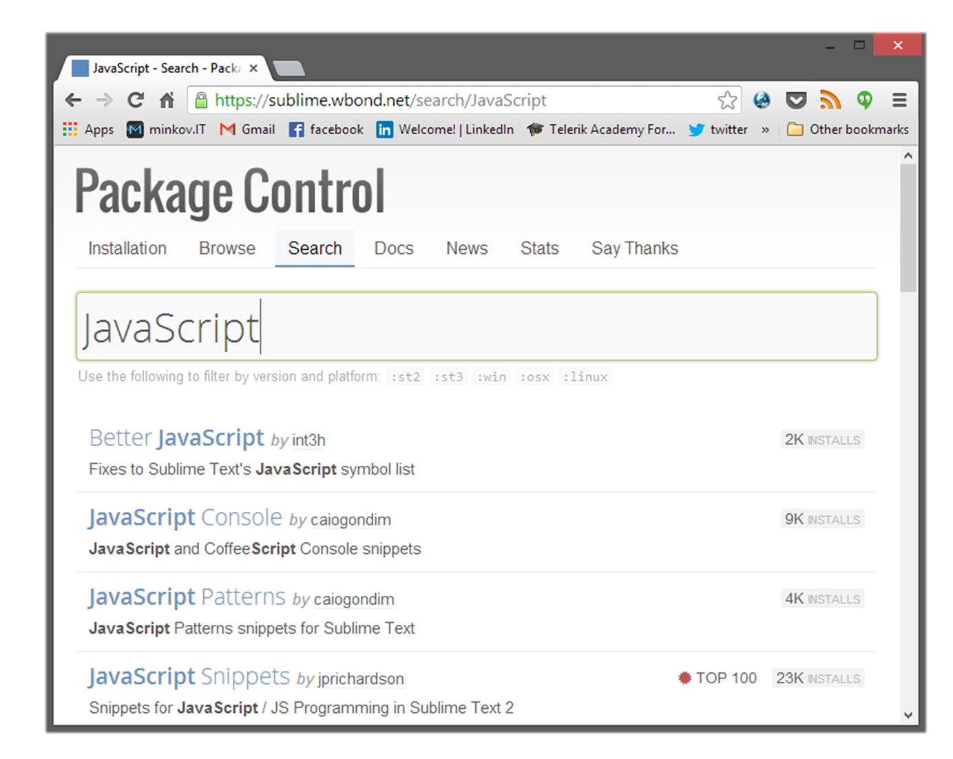
Sublime Text 2 Plugins
Live Demo

Slide 15
Sublime Text 2 JavaScript Plugins
List of useful plugins for JavaScript development:
Less2css – compiles LESS code to CSS
JsFormat – formats JS code
SublimeLinter – adds static code analysis for JS
BracketHighligher – highlights opening and closing brackets
jQuery – adds jQuery bundles

Slide 16
Sublime Text 2 Plugins for JavaScript
Live Demo

Slide 17

Visual Studio

Slide 18
Visual Studio
Visual Studio is the main development tool for creating applications with the .NET framework
ASP.NET, WPF, Silverlight, SharePoint, Windows 8, etc…
Until Windows 8 and version 2012, Visual Studio was not a pleasant tool for coding JavaScript
Microsoft put JavaScript into the core of Windows 8, so their development tool needed to be done right
Use Visual Studio 2012 or Visual Studio 2013

Slide 19
Visual Studio 2012/2013
VS 2012/2013 are pretty much ready-to-use for JavaScript coding
They have pretty good intelli-sense, code highlighting, etc…
There are paid and free versions (Visual Studio 2012/2013 Web Developer)
Visual Studio Code is a free version
For now only works for HTML/CSS and JS

Slide 20
Visual Studio 2012/2013
Live Demo

Slide 21
Jetbrains WebStorm

Slide 22
Jetbrains WebStorm
Jetbrains WebStorm is a ready-to-use IDE for JavaScript development
Including web development with HTML and CSS
WebStorm has most of the necessary features for web development
Code highlighting, code completion
Has not that many plugins
WebStorm is a paid software
Yet, Jetbrains offer a discount (100%) for students

Slide 23
Jetbrains WebStorm
Live Demo

Slide 24
Debugging JavaScript
Using All the Tools

Slide 25
Debugging JavaScript
Sadly, no intelligent way of debugging client-side JavaScript
The only way to debug JavaScript is through the browser
Fortunately all browsers have their own debugging tool/plugin that makes it easier
Firefox has Firebug
Chrome and Opera have Web developer
Internet Explorer has F12

Slide 26
Debugging JavaScript
Live Demo

Slide 27
JavaScript Utilities

Slide 28
JavaScript Utilities
JavaScript Code Quality Tools
http://www.jshint.com/
http://www.jslint.com/
HTML, CSS and JavaScript playgrounds
http://jsbin.com
http://liveweave.com
JavaScript performance tester
http://jsperf.com

Slide 29
JavaScript Utilities
Live Demo

Slide 30
JavaScript Tools
http://academy.telerik.com

Slide 31
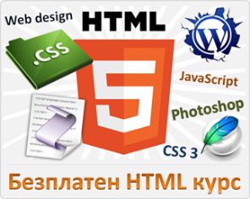



Free Trainings @ Telerik Academy
"Web Design with HTML 5, CSS 3 and JavaScript" course @ Telerik Academy
html5course.telerik.com
Telerik Software Academy
academy.telerik.com
Telerik Academy @ Facebook
facebook.com/TelerikAcademy
Telerik Software Academy Forums
forums.academy.telerik.com

